Slide 1
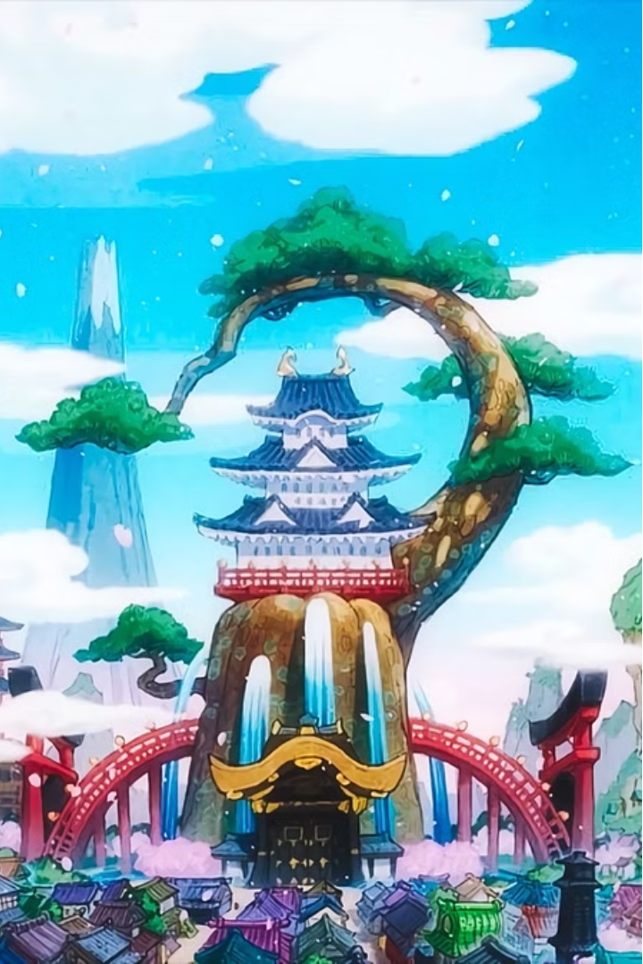


One Piece: The Legendary Anime
One Piece is a beloved anime that has captivated audiences worldwide with its epic adventure, captivating characters, and unforgettable moments. From the ambitious dreams of Monkey D. Luffy to the stunning visuals of the Grand Line, this series is a true masterpiece of Japanese animation.

Slide 2
Cartoon vs. Anime: Distinct Styles
Cartoons
Anime
Key Differences
Cartoons often feature simplified character designs, exaggerated movements, and a focus on slapstick humor. They are typically aimed at younger audiences.
Anime is characterized by detailed character designs, more realistic animations, and a diverse range of genres and storytelling styles. Anime often explores complex themes and appeals to a wider age group.
The distinct visual styles, narrative approaches, and target audiences set cartoons and anime apart as unique forms of animated entertainment.

Slide 3
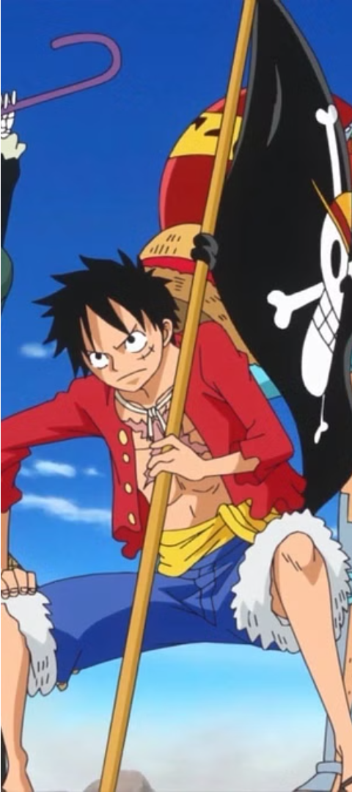
Monkey D. Luffy and the Straw Hat Pirates
1
Luffy: The Aspiring Pirate King
2
The Straw Hat Crew
A diverse group of colorful characters, each with their own unique skills and personalities, who accompany Luffy on his grand adventure.
A charismatic and determined young man who dreams of becoming the King of the Pirates.
3
Unbreakable Bonds
The strong camaraderie and unwavering loyalty between Luffy and his crew are at the heart of the One Piece story.

Slide 4
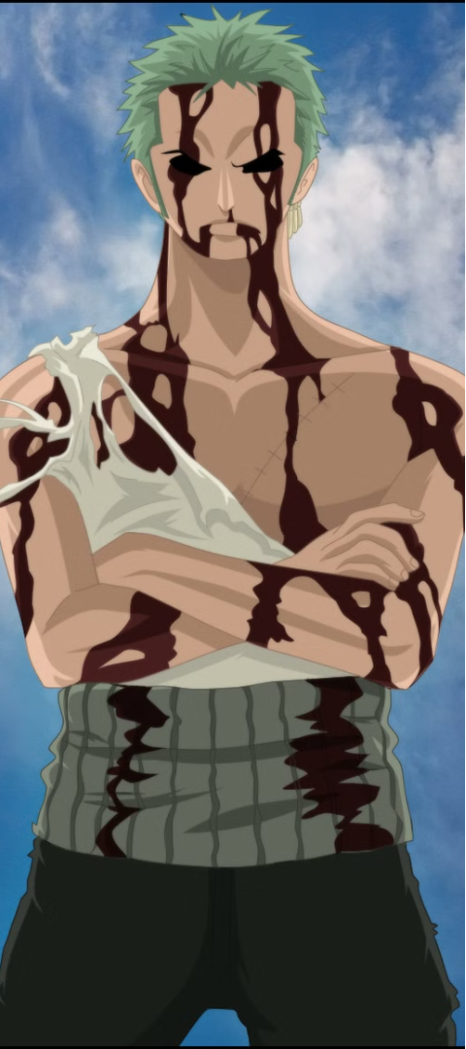
"Nothing Happened": Zoro's Iconic Sacrifice
1
The Incident
Zoro, Luffy's loyal swordsman, takes on the pain and injuries of his captain, refusing to let Luffy be harmed.
2
Zoro's Resolve
His unwavering determination to protect his captain and crew at all costs is a testament to his strength of character.
3
The Aftermath
This selfless act, and Zoro's famous line "Nothing happened," has become one of the most iconic moments in the entire One Piece series.

Slide 5
Iconic Villains of One Piece
Crocodile
Donquixote Doflamingo
A ruthless and cunning ex-Warlord of the Sea, known for his manipulative schemes and deadly Devil Fruit powers.
A former World Noble turned pirate and crime lord, with a penchant for sadism and an ability to control people like puppets.
Kaido
Big Mom
The fearsome "Strongest Creature in the World," a towering and seemingly invincible Beast Pirate captain.
A ruthless Yonko with a volatile temper and a craving for sweets, who rules over the powerful Charlotte Family.

Slide 6



Devil Fruits and Unique Abilities
Devil Fruits
Haki
Awakening
Mystical and powerful fruits that grant users extraordinary abilities, ranging from elemental control to shapeshifting.
A form of spiritual energy that allows users to enhance their physical abilities or predict their opponent's moves.
The ultimate stage of a Devil Fruit's power, where users can manipulate their surroundings in extraordinary ways.

Slide 7



Emotional Storylines and Character Development
Tragedy
Redemption
Friendship
One Piece explores profound themes of loss, sacrifice, and the weight of the past, tugging at the heartstrings of its audience.
Many characters undergo remarkable transformations, finding the strength to overcome their pasts and become better versions of themselves.
The deep bonds forged between the Straw Hat crew and their allies are a core element of the series, showcasing the power of camaraderie.

Slide 8
Luffy's Dream: Becoming the King of the Pirates
Ambition
Luffy's unwavering goal is to find the legendary treasure, the One Piece, and become the King of the Pirates.
Challenges
Along the way, he and his crew face formidable foes, treacherous seas, and daunting obstacles that test their resolve.
Determination
Luffy's boundless determination and the unbreakable bonds with his crew drive him forward, inspiring others to pursue their own dreams.

